Slide 1

AEC MID EVAL
Manikya Pant
Nitin Ram Sai

Slide 2
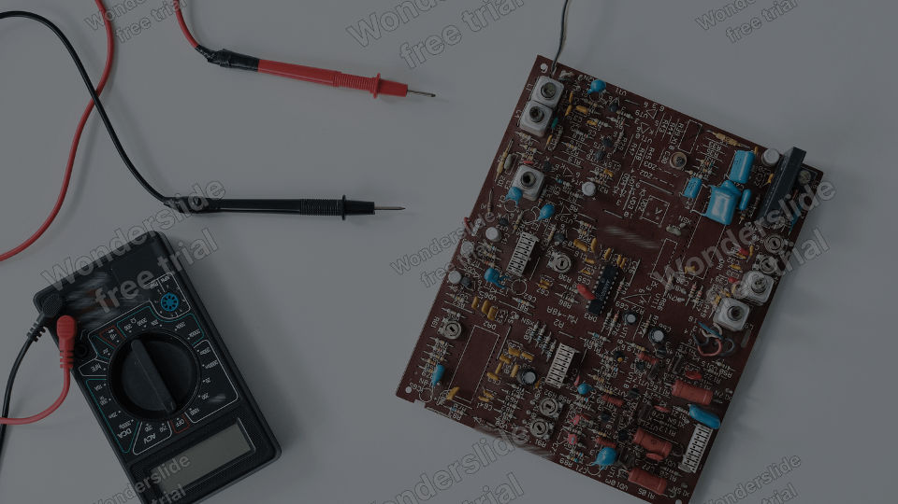
Design LT Simulations for: > LPF > Mixer > Oscillator
Project Workflow:
Resemble Simulations on Hardware and Verify
Prepare Project Report

Slide 3
Quadrature Down Converter Project
Making a quadrature down converter for modern wireless receivers
Implementing a switch (mixer), quadrature oscillator, and simple RC low pass filter
Assembling all components and implementing the Quadrature Down Converter

Slide 4
LT SPICE SIMULATION

Slide 5
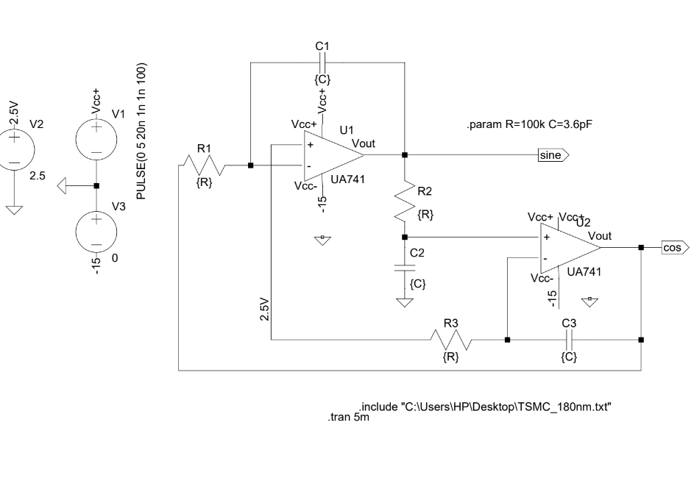

Slide 6
Mixer
Mixes two signals by switching action

Slide 7
The quadrature oscillator has two outputs, one generates a sine wave and the other generates a cos wave with same frequency and amplitude.
This oscillator consists 2 op-amps from which sine and cos waves are generated, set of resistors and capacitors whose network is fed back to the input of op-amp and thus they acts as integrator circuits.
The noise signal given in the circuit goes into one of the op-amp and gets amplified and upon multiple integrations it becomes a sine wave in saturation. This sine wave output is fed back to another op-amp which again integrates the signal, thus generating a cos wave
There are even diodes and a resistive divider across the diodes and one feedback path of op-amp to control the voltage of the output as well.
The resistor and capacitor values in the feedback path are calculated from the relation output frequency (f) = 1/(2πRC) where R,C are the values of resistance and capacitance of capacitors in all the feedbacks which are the same.
As Frequency required is 100kHz we fix the Resistance to 1kΩ and C=1/2πFR which is 1.59nF.
Though, we observed less frequency than the desired at the output, from calculated values of R and C, we decreased the resistance keeping capacitance constant till we observe the desired output frequency.

Slide 8
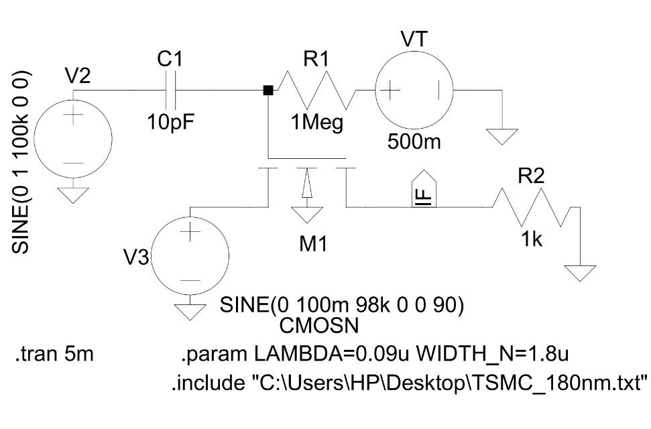
Mixer

Slide 9
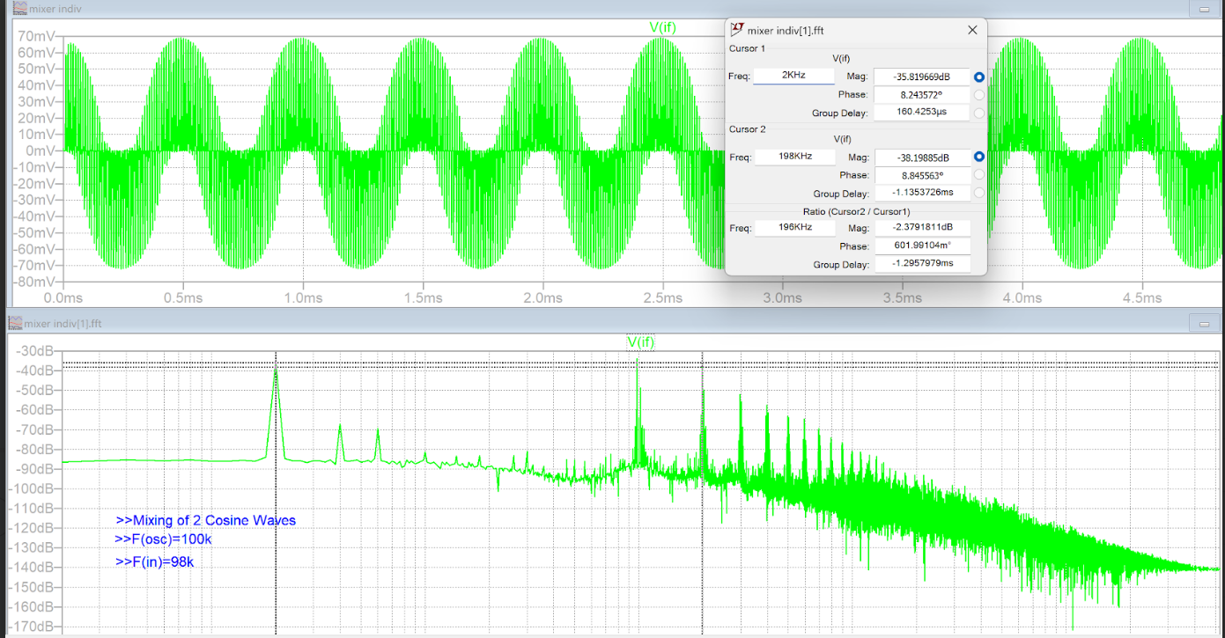
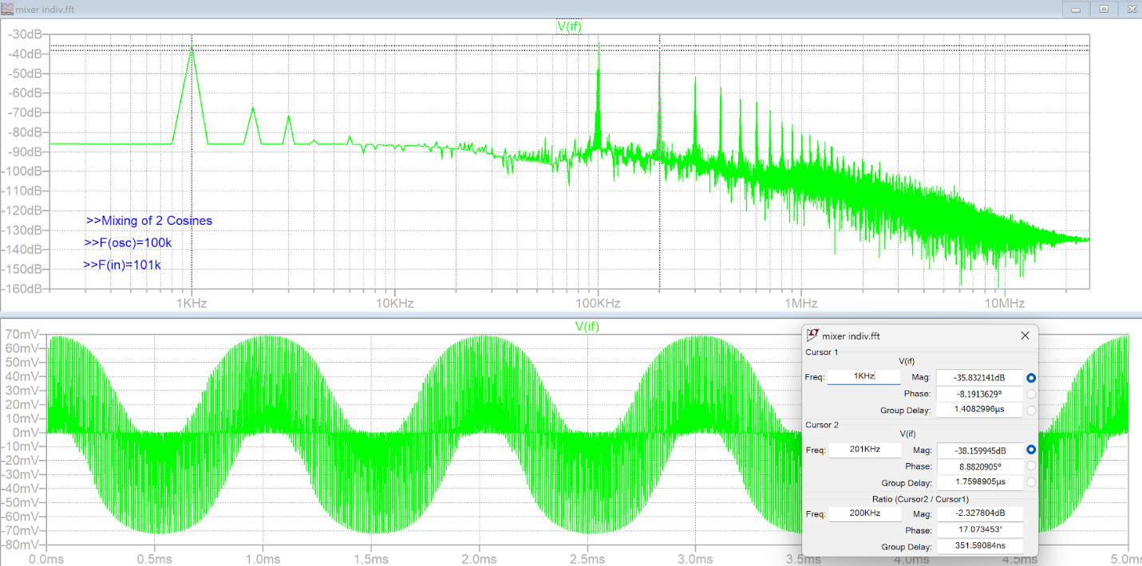
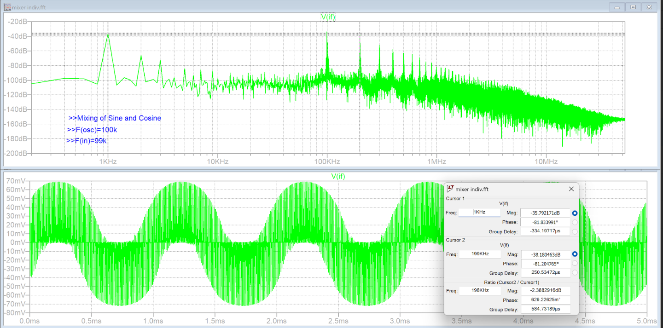
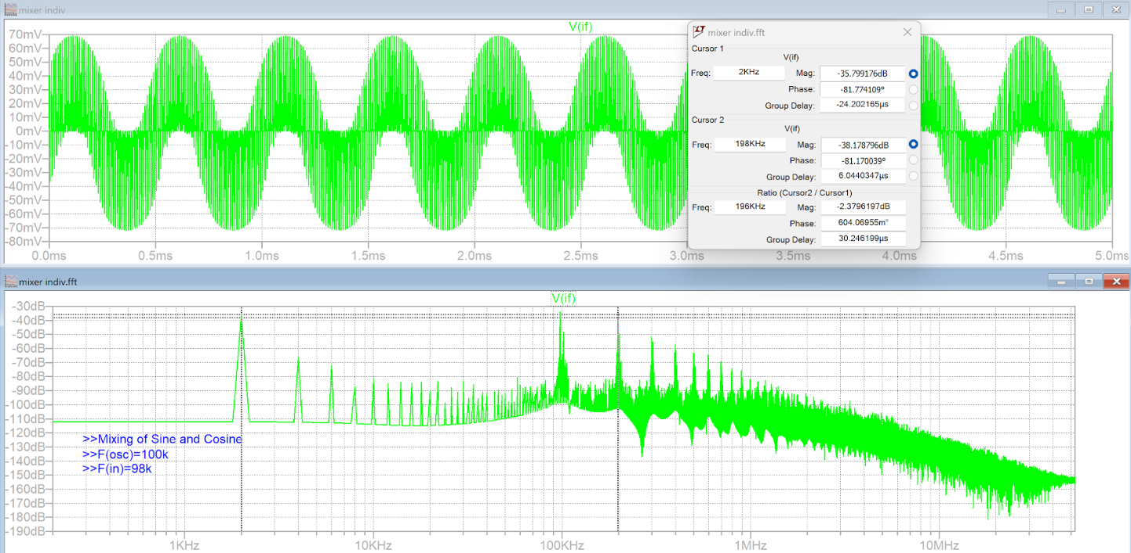

Slide 10
Low Pass
Filter

Slide 11
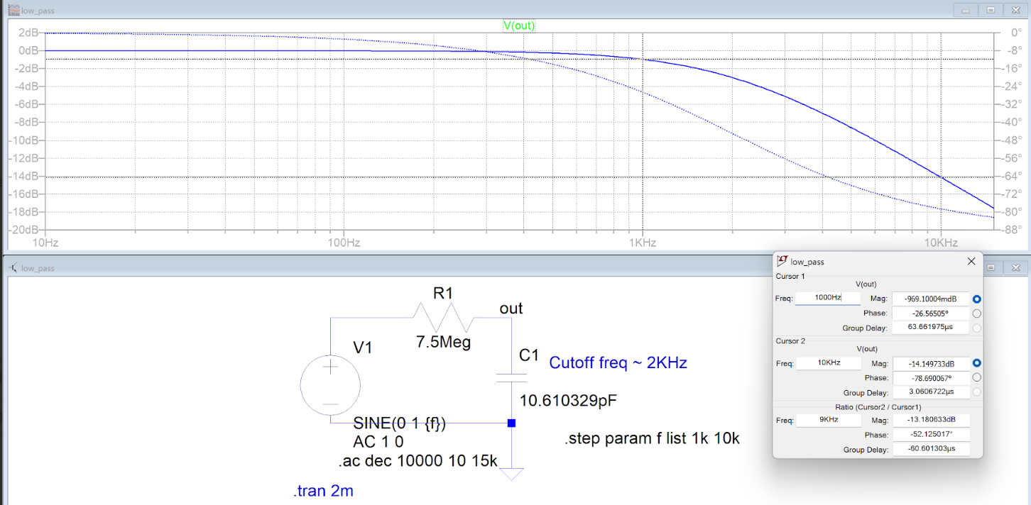

Slide 12
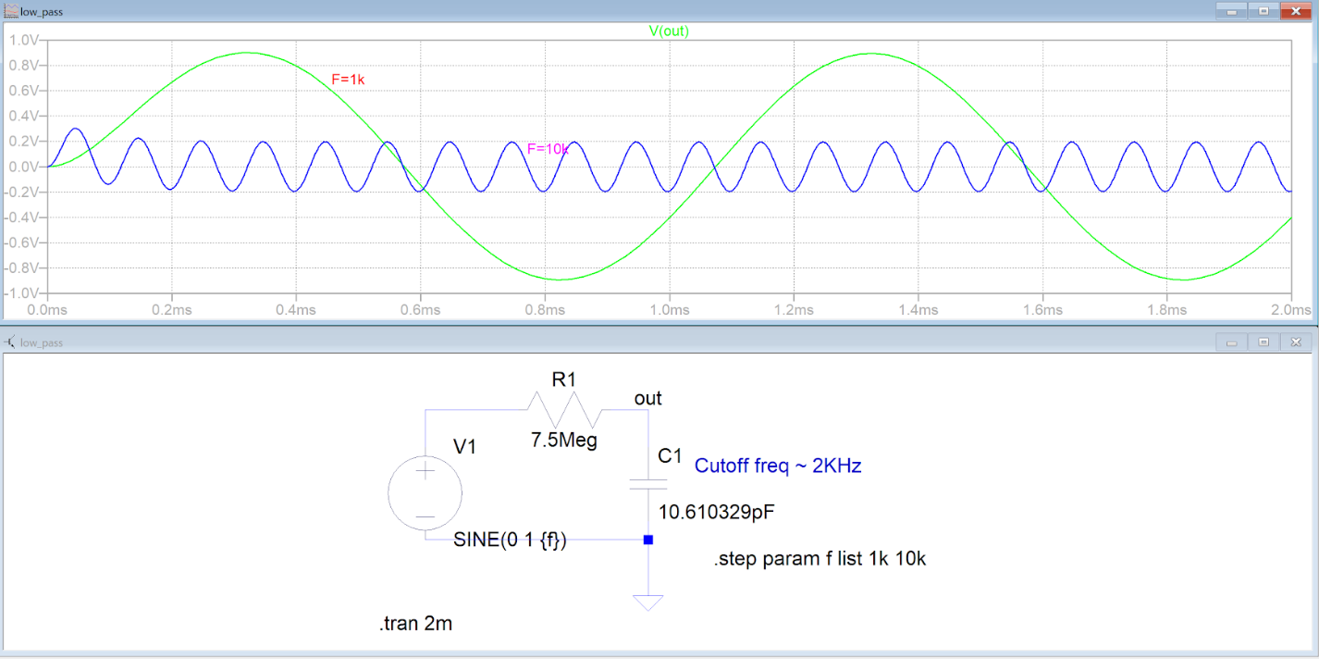

Slide 13
Low Pass
Filter + Mixer Combined

Slide 14
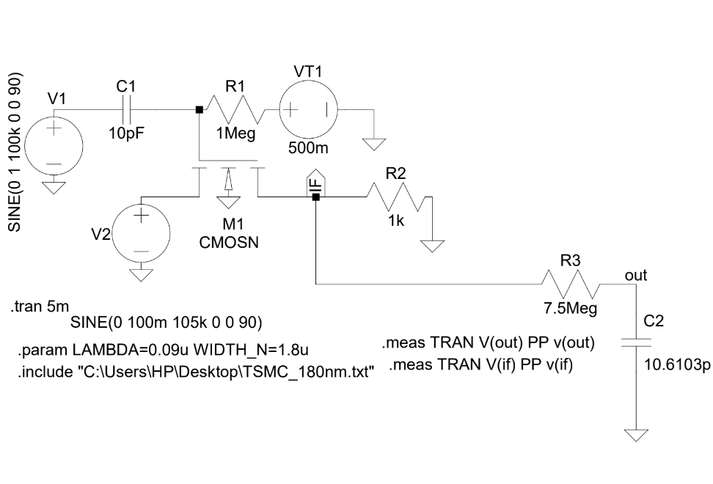

Slide 15
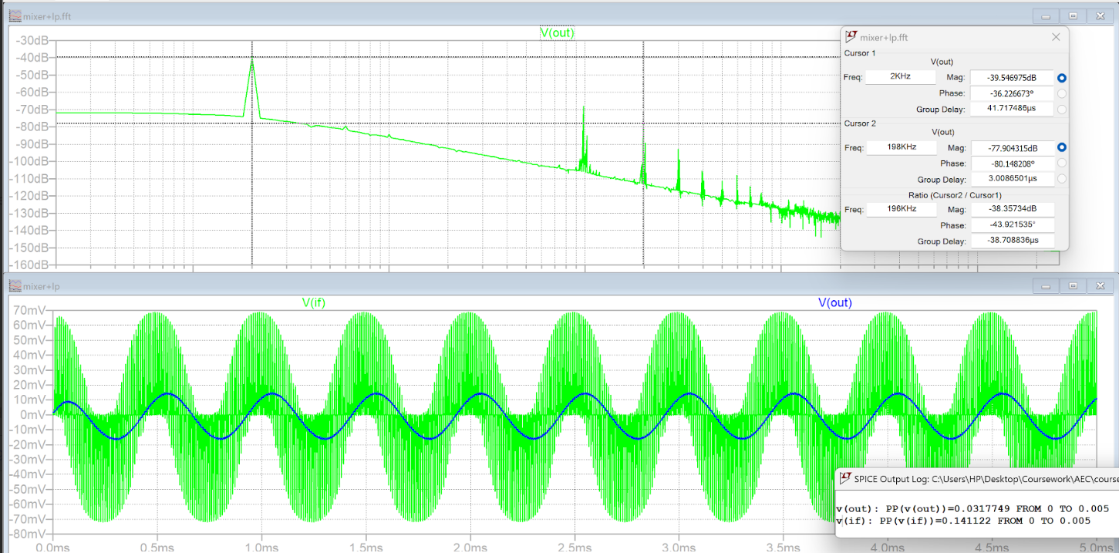

Slide 16
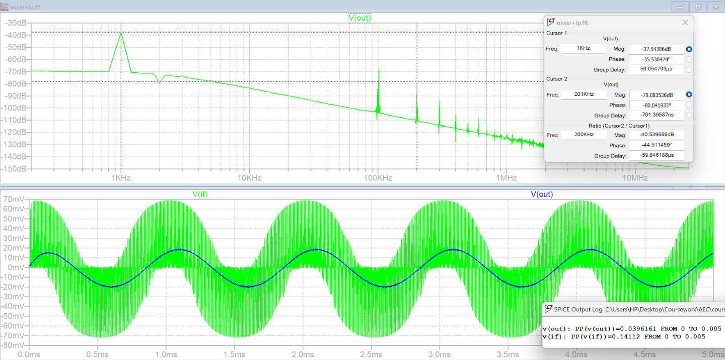

Slide 17
Quadrature Oscillator

Slide 18
The output of the mixer is the product of two signals:
One is the input signal.
The other one is the square pulse which is generated due to continuous on-off of the MOSFET.
The output signal will have frequencies of w(in) - w(osc) and w(in)+w(osc).
As we are cascading oscillator with the switch, we put a coupling capacitor in between to avoid any disturbance at the output.
For Spice simulations, we have given certain width and length to the MOSFET and calculated it's threshold voltage from it's characteristic curve. The bias voltage is also given around the threshold voltage of the NMOS used.
Whenever the sum of oscillator voltage and bias voltage exceeds the threshold voltage, the MOSFET gets on and allows input to flow from source to drain.
But as frequency of oscillator is very high, the MOSFET switches on and off quickly and thus the input signal gets multiplied with the square wave (due to switch behavior of MOSFET) and appears at the output.
And from the FFT of the output signal, we observe three major peaks at frequencies w(in) - w(osc) , w(in) , w(in) + w(osc)

Slide 19
Full Circuit

Slide 20
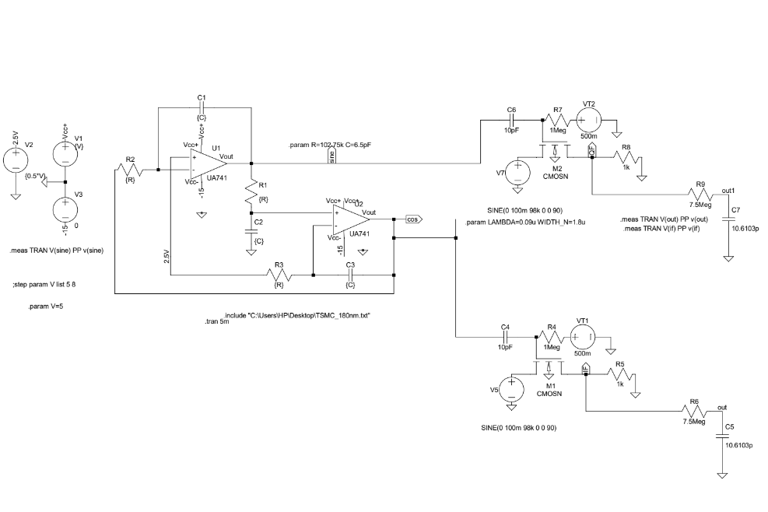

Slide 21
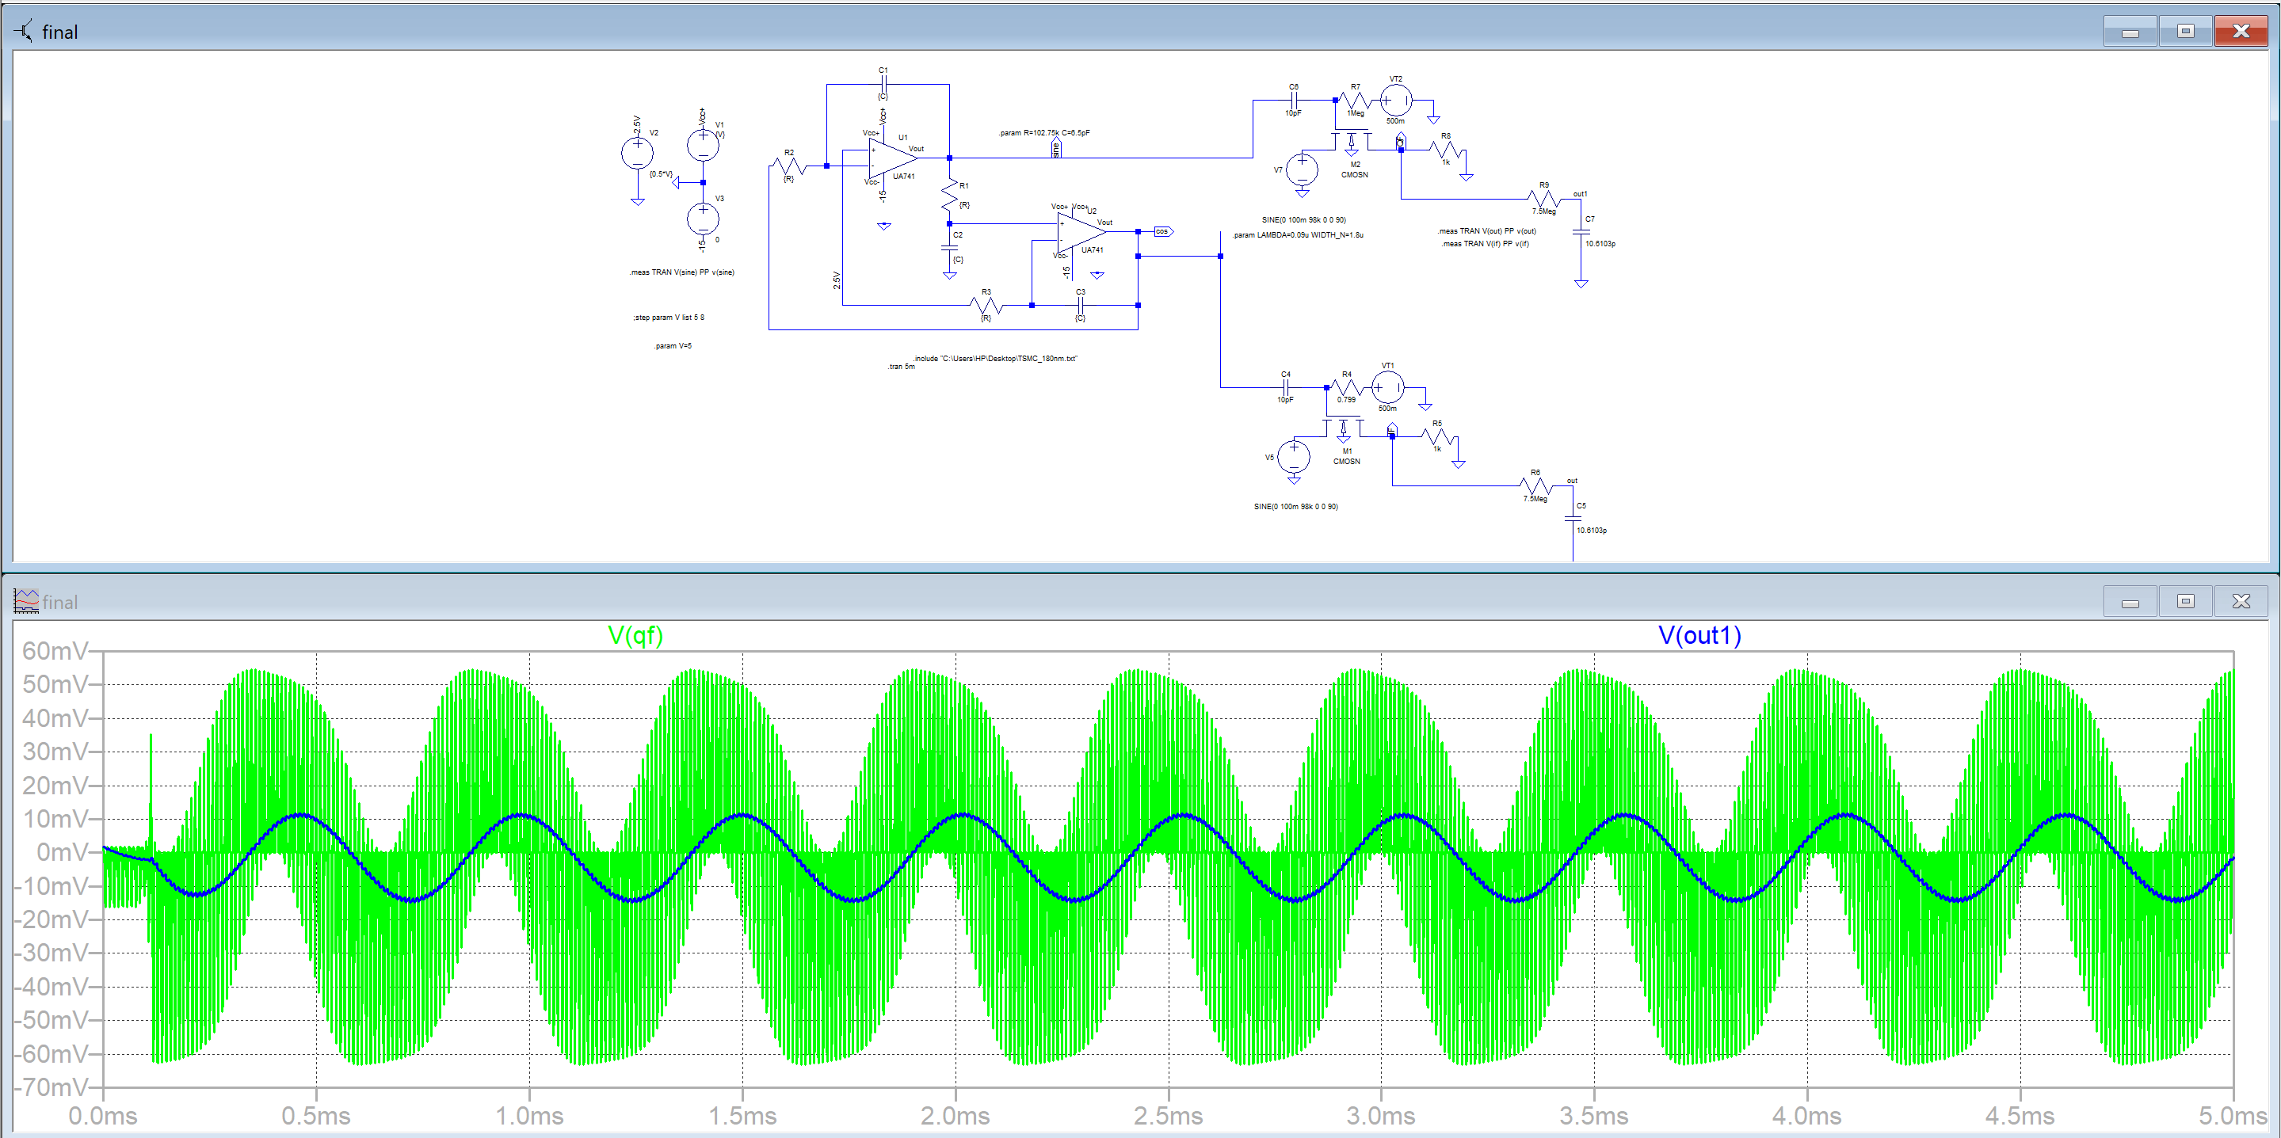

Slide 22
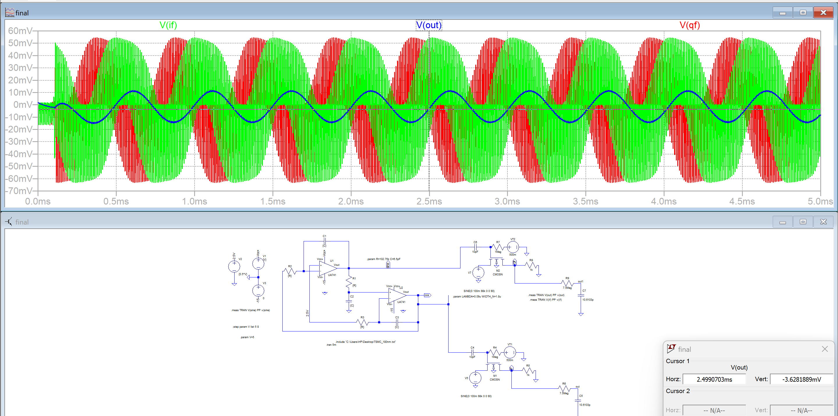
Full Circuit

Slide 23
Thank You

